Slide 1
Assignment 3-4 Presentation
Presented by:
Aakash Ur Rehman (FA19-BSE-112)
Muhammad Abu Hurairah (FA19-BSE-033)
To:
Miss DR. Fatima Sabir

Slide 2
Outline of the Presentation
Background
Problem Statement
Proposed Solution
Experiments
Results
Accuracy
References

Slide 3
Background
Generating the documentation of code through different tools such as SPARX, PMD
Reverse Engineering of the code for refactoring
Project Management tools for manage the code such as Jira, Asana.

Slide 4
Problem Statement
Project Travel Application calculates fares between two cities.
Project task distribution among team members is not allocated among the companies and wants to revise the application.

Slide 5
Proposed Solution
For the code Documentation or reverse engineering, use the Sparx for generating different diagrams such as Class
Use the GitHub for the management of code between the team members.
Using Jira, assign the duties to the team member such as changing the code and complete the tasks within allocated deadline.
Through these platforms, can generate the different reports for the analysis of team activities.

Slide 6
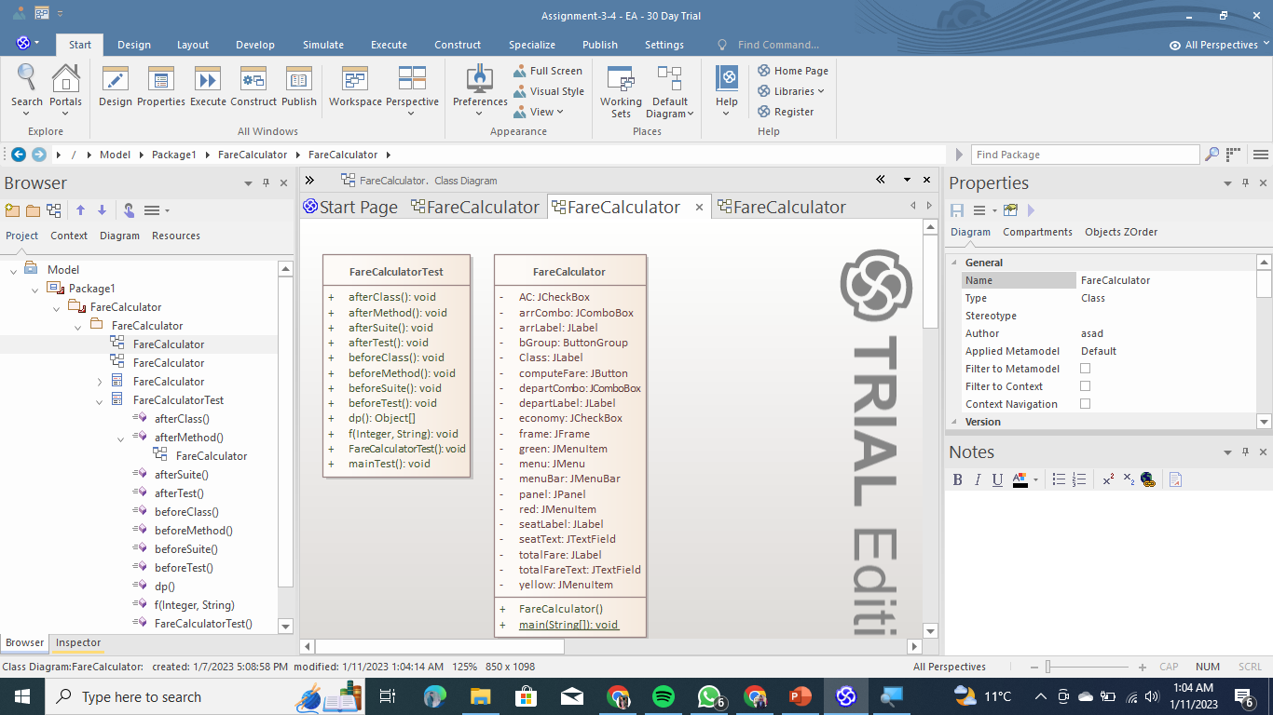
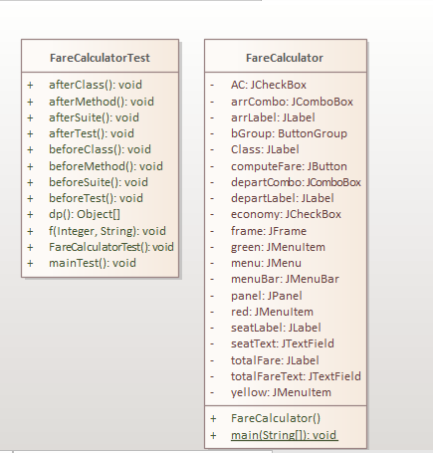
Code Documentation through Sparx

Slide 7
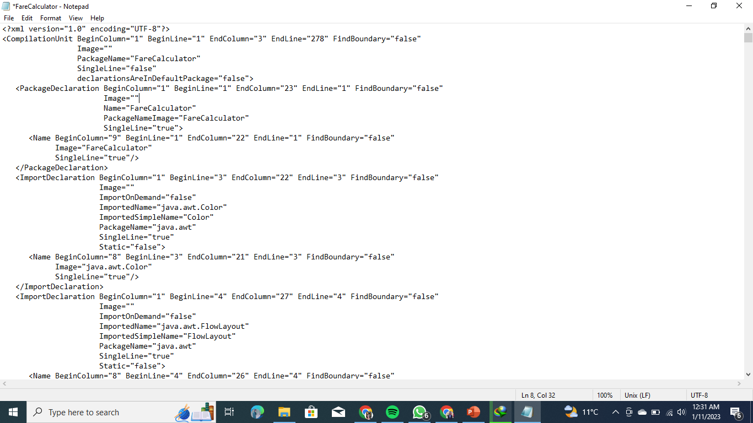
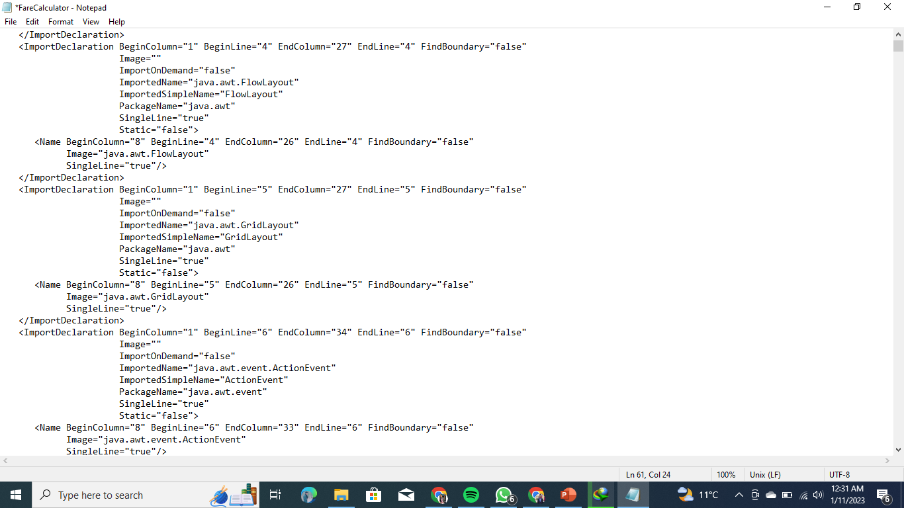
Abstract Tree

Slide 8
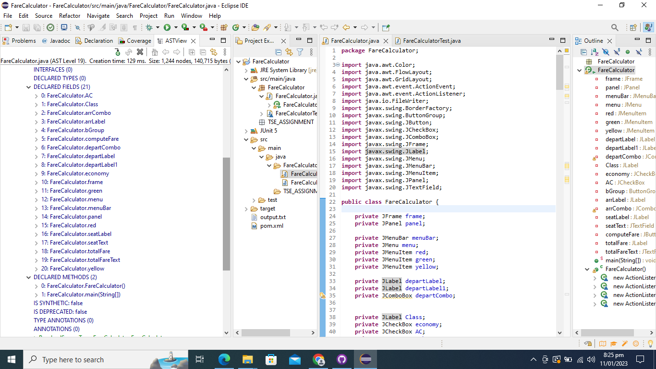
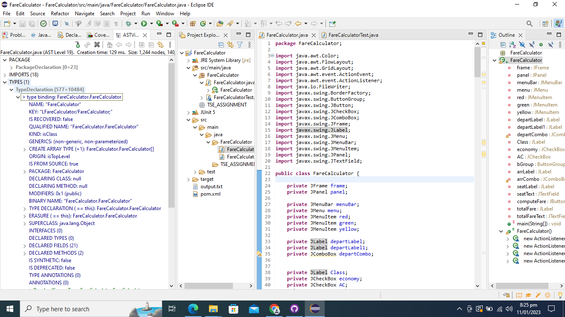
Abstract Tree

Slide 9
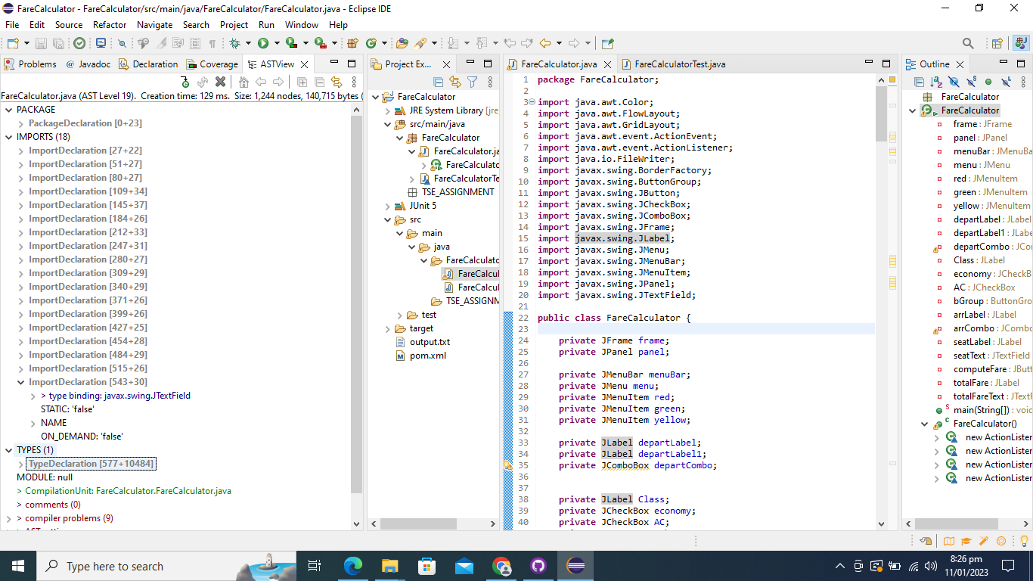
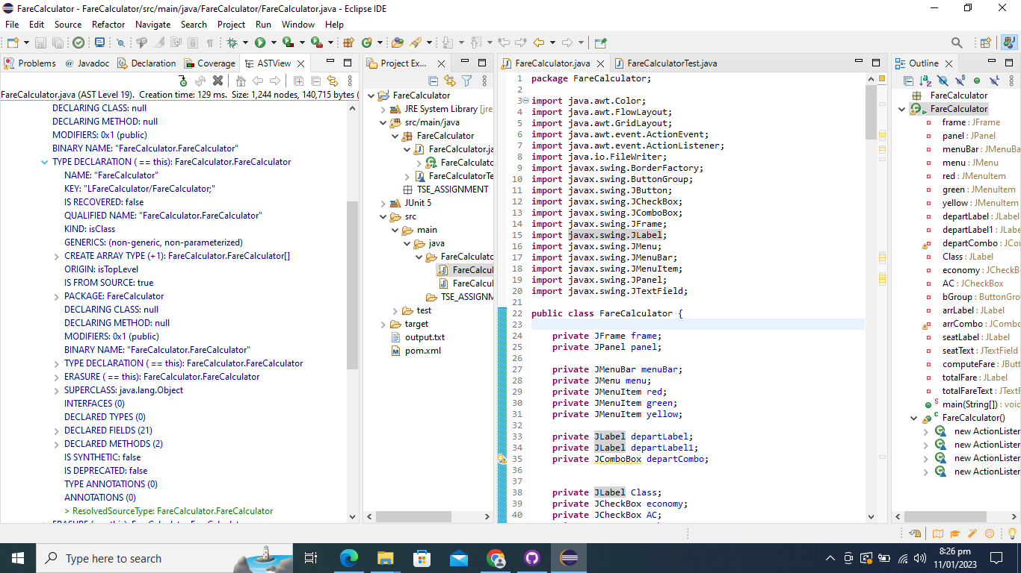
Abstract Tree

Slide 10
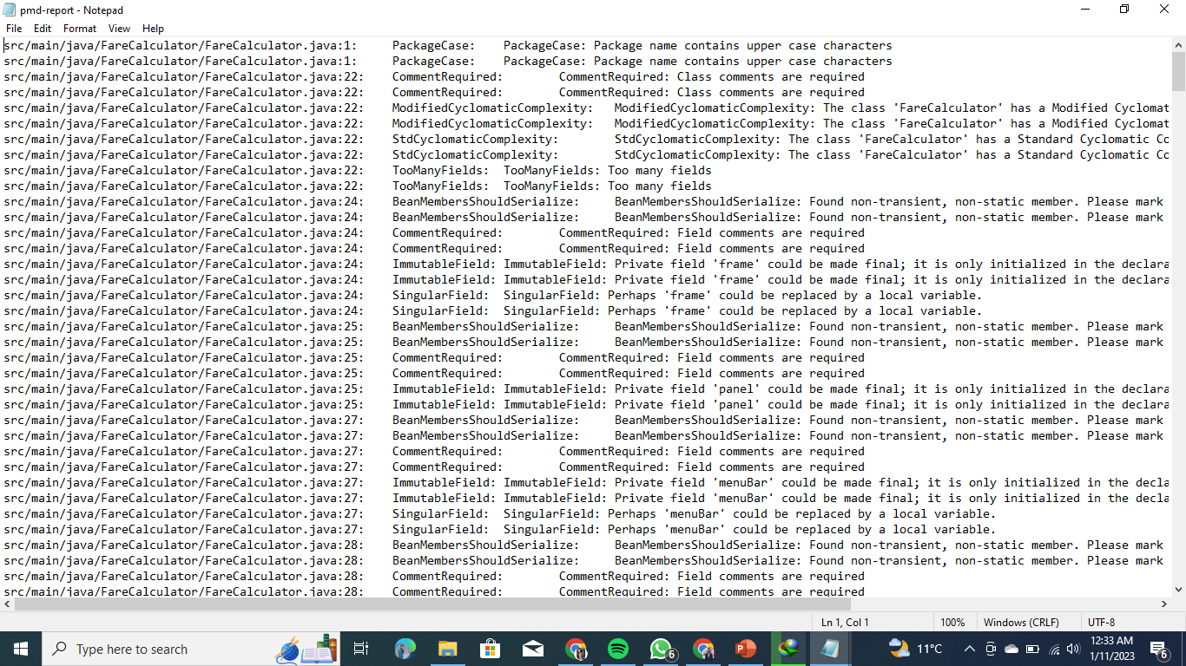
Code Report through PMD

Slide 11
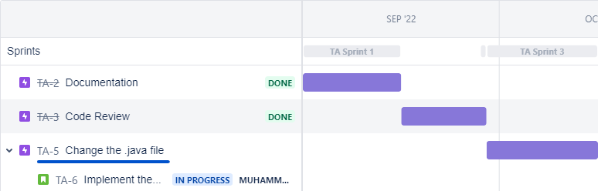
Division of Project into Sprints

Slide 12
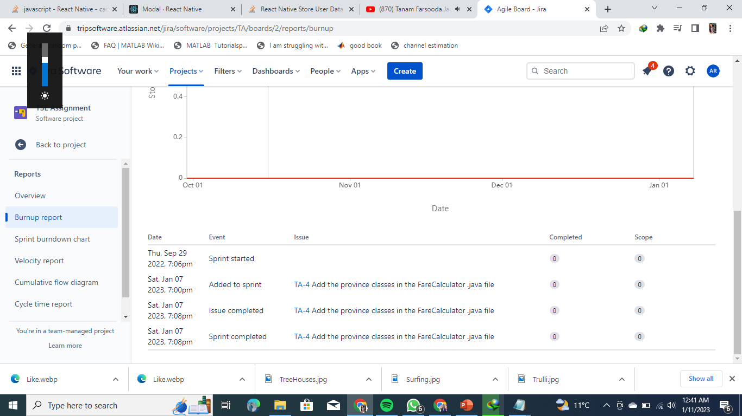
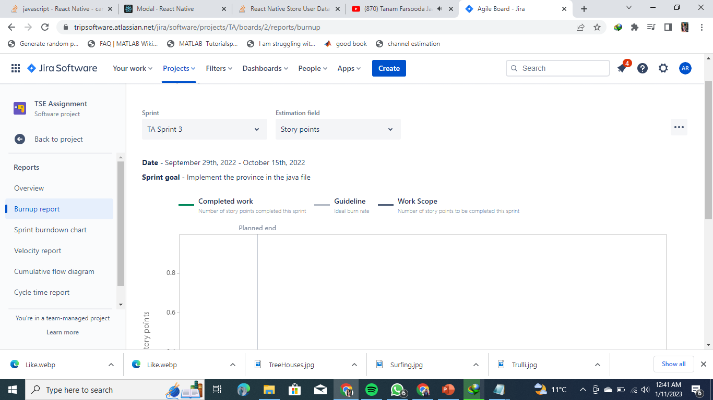
Jira Report

Slide 13
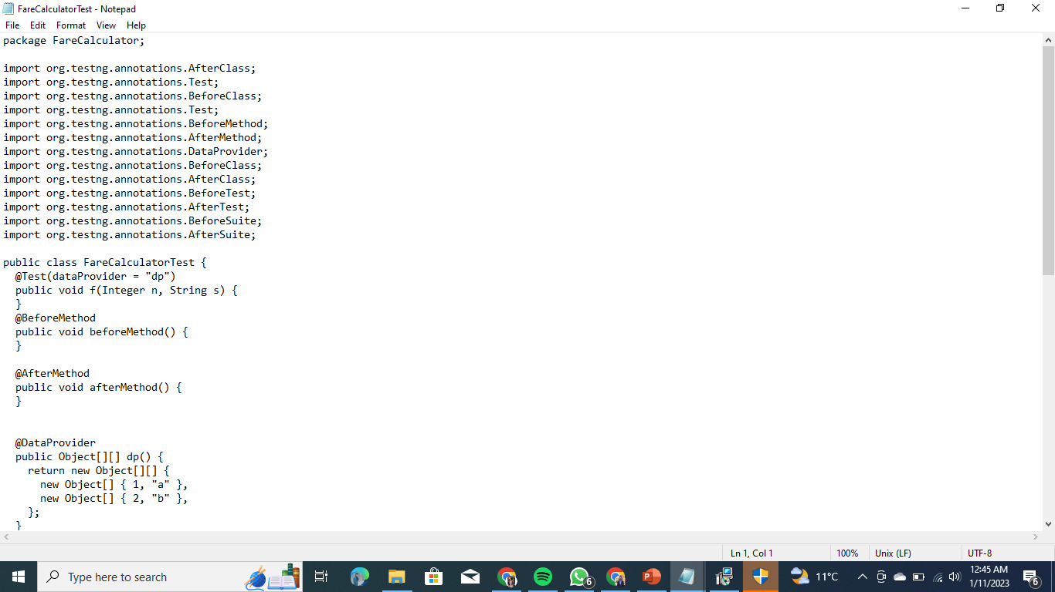
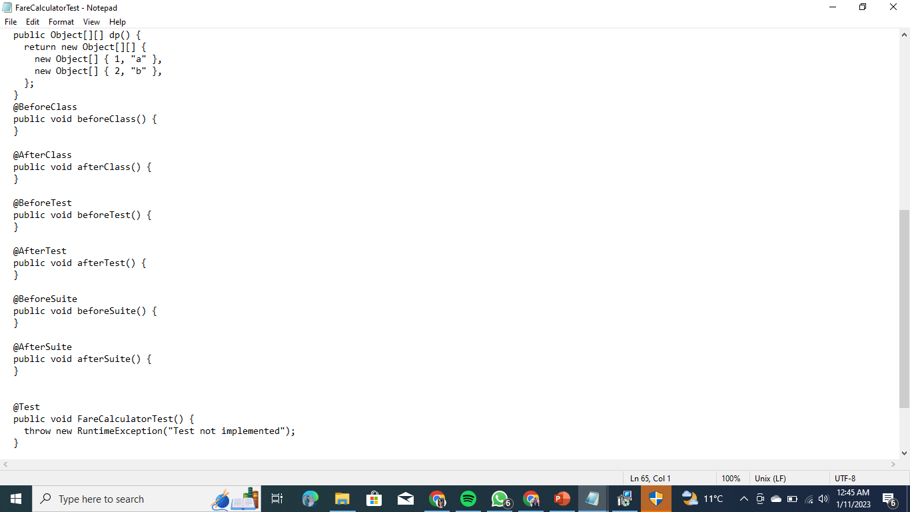
Automated tests

Slide 14
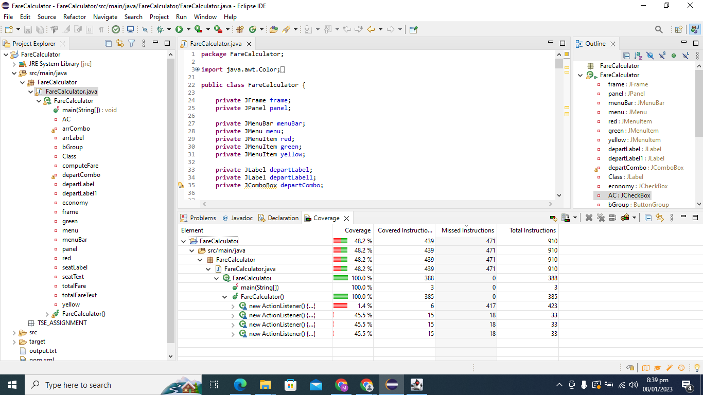
CODE COVERAGE

Slide 15
Results
Generate class diagram design of code using Sparx.
Make Abstract Tree.
Develop code report using PMD
Project changes managed by Jira tool.
Create updated code file after required changes .
Get code coverage value using Junit.

Slide 16
Accuracy
Code Coverage Value is 48.2

Slide 17
References
GitHub Repo Link
https://github.com/mabuhurairah/TSE-Assignment
Jira Link
https://tripsoftware.atlassian.net/jira/software/projects/TA/boards/2/roadmap

